Slide 1
Elaboré par : Aymen Tlili (2IDSD1)
Projet Deep Learning : Initiation à un systéme de recommendation

Slide 2
Project outline
When Making a Recommender System . What Questions do we want to Answer ?
What makes a User engage in clicking on a Song ?
How can we detect user Habits ?
What drives user prefrence ?
What drives users to Explore new things ?
Users only watch 1% of our Library . how to fill out the rest of the ratings?
How can the problem scale with time ?

Slide 3
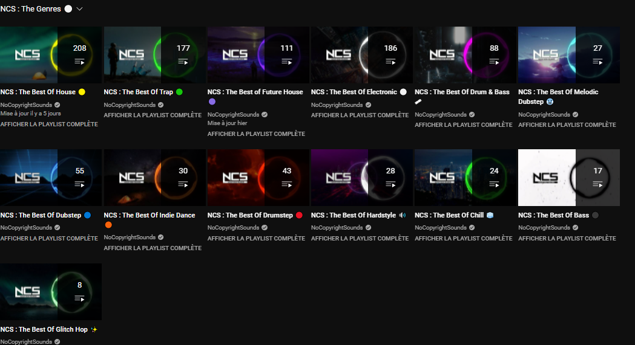
Our data

Slide 4
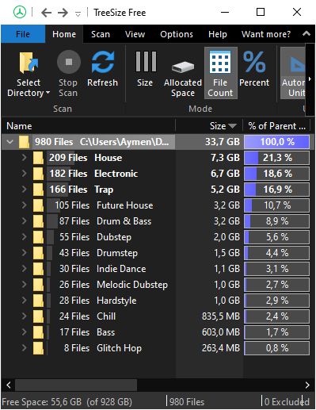
Our Scraped Data (.wav files)

Slide 5
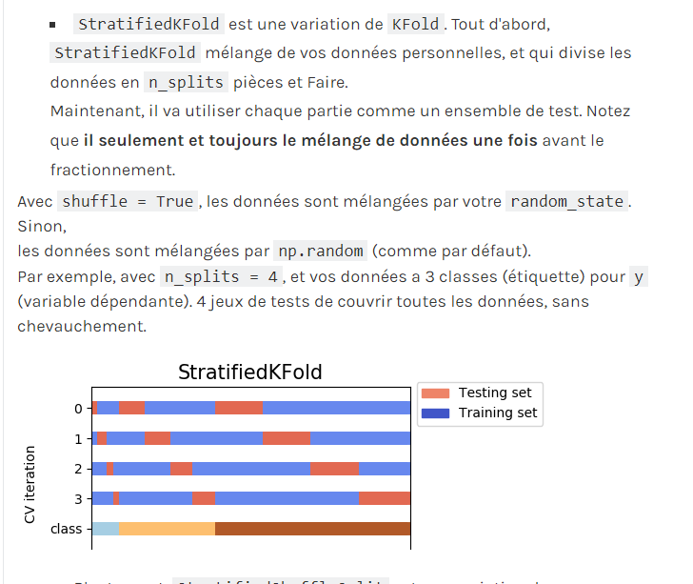
Solution for the imbalanced data

Slide 6
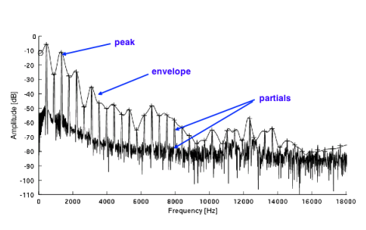
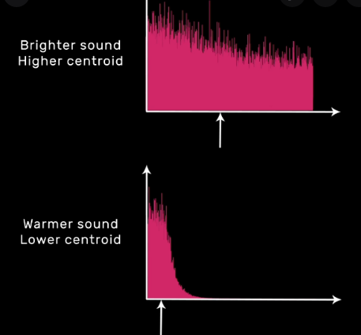
Traditional ML pre-processing pipeline
Amplitude envolope
Spectral Centroid

Slide 7
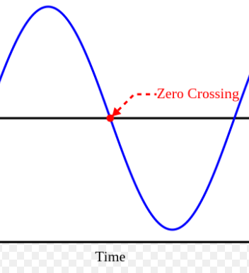
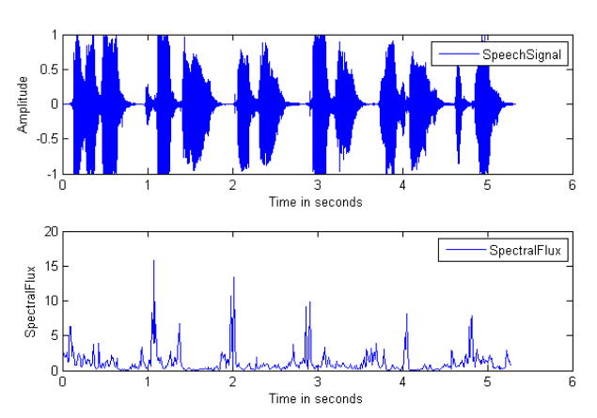
0-crossing rate
Spectral Flux

Slide 8
GOALS :
->Feature engineering
->STFT
-> Time and Frequency features

Slide 9
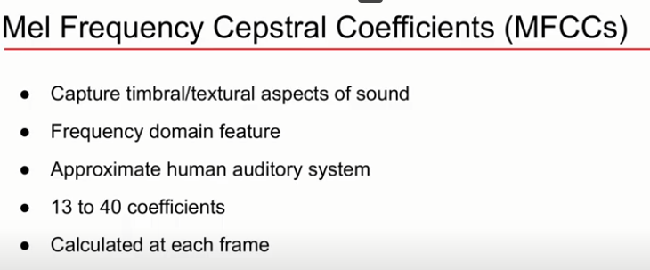
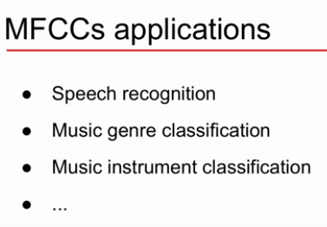

Slide 10
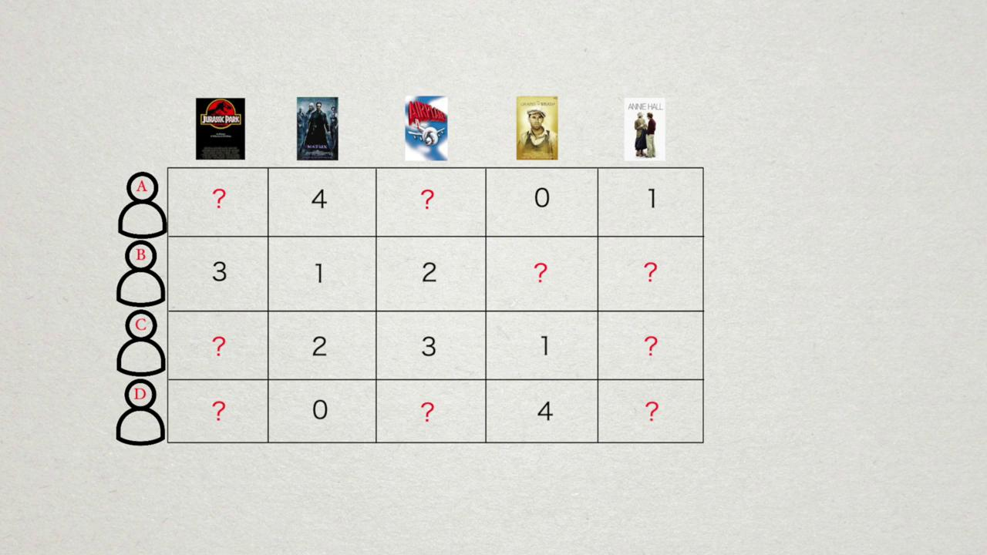
Recommender system Functionality

Slide 11
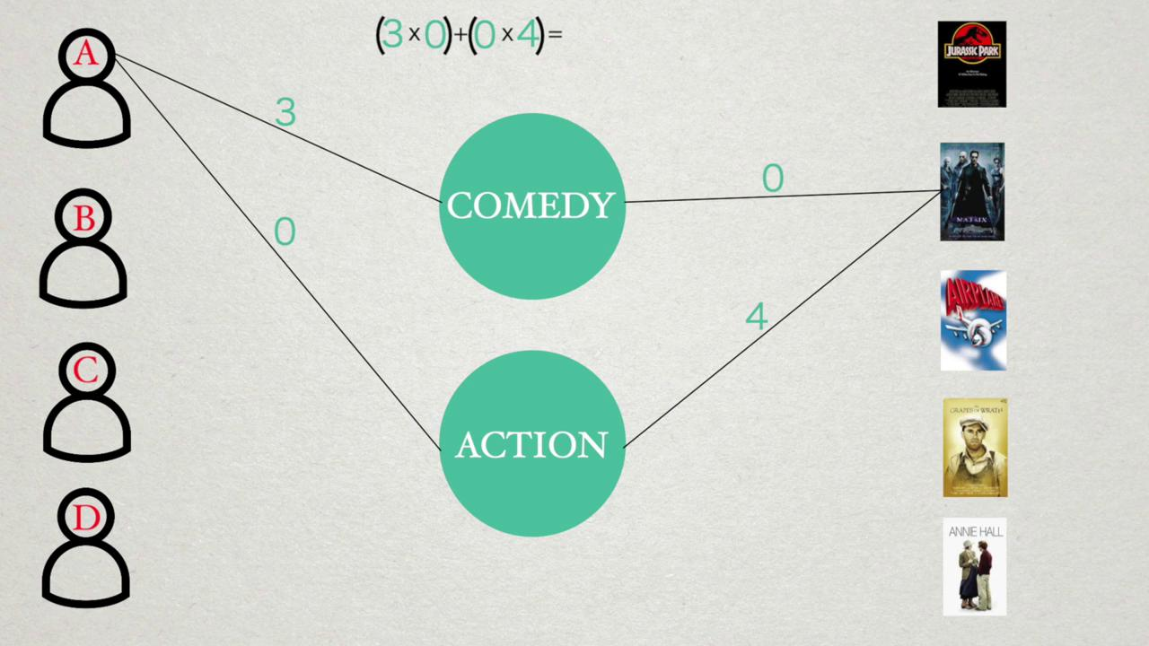
0-th Approach:

Slide 12
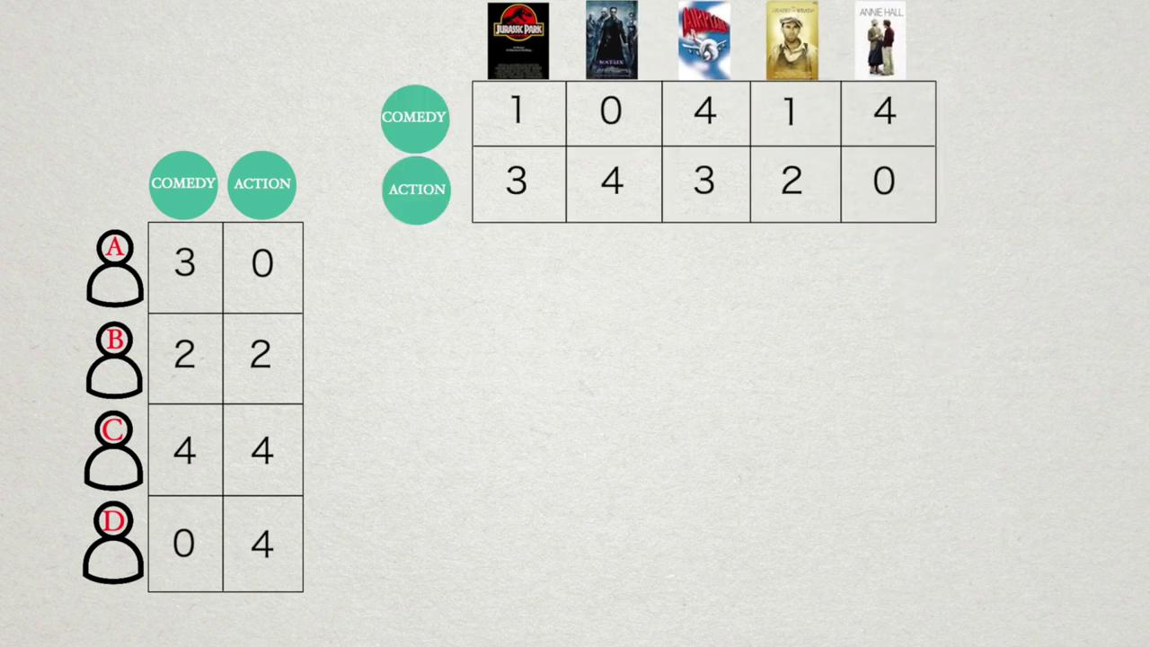
0-th Approach:

Slide 13
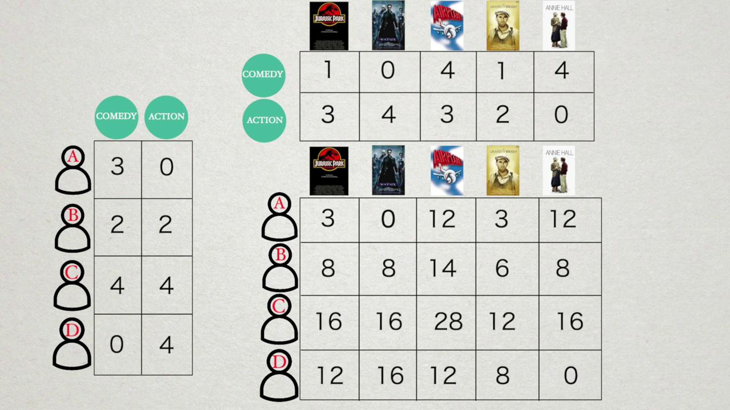
0-th Approach:

Slide 14
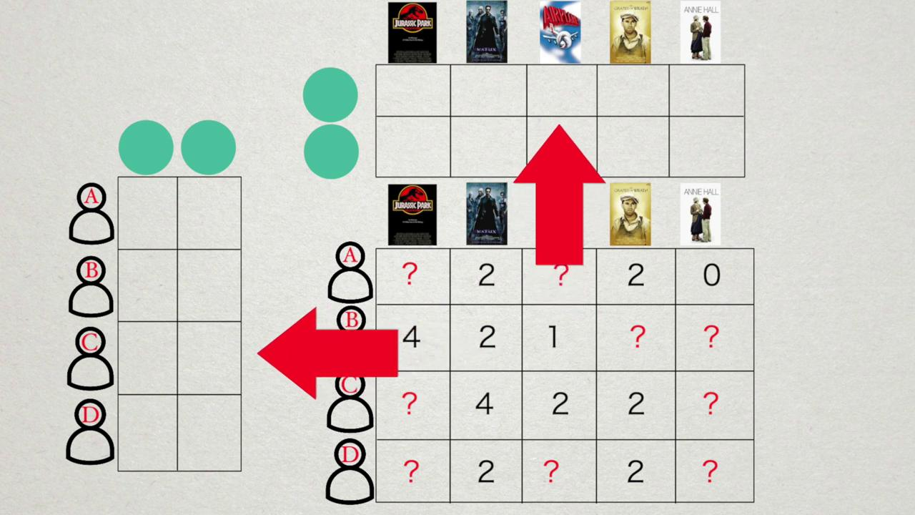
^{1nd} Approach :Content Based Recommendation

Slide 15
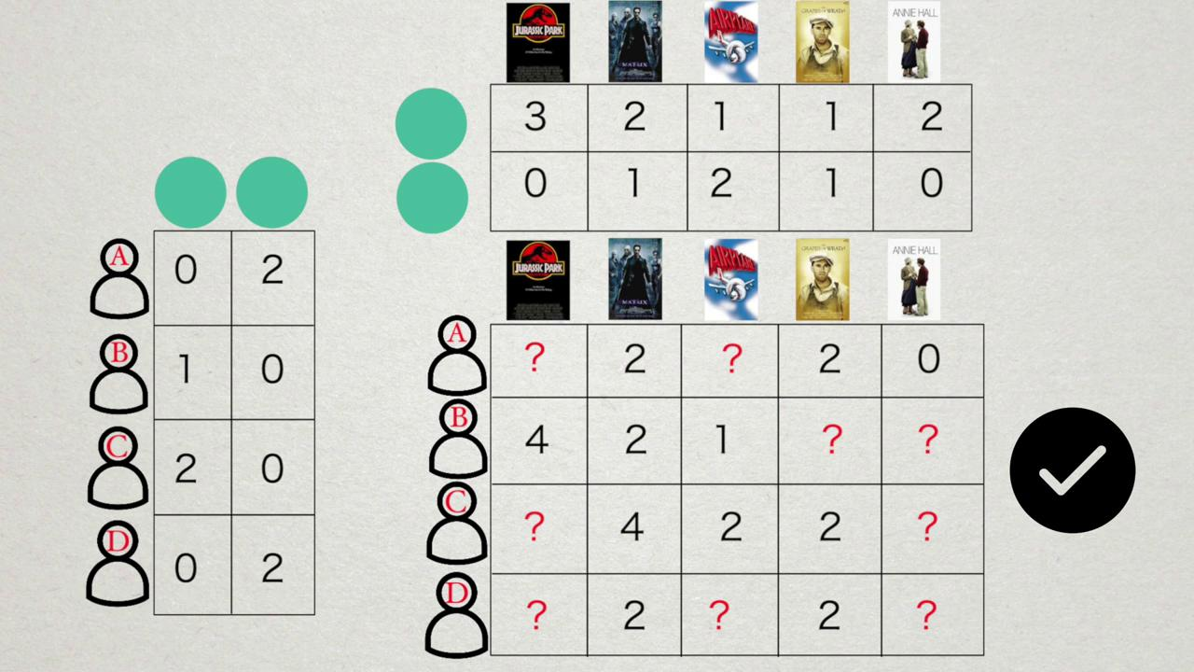
^{1st} Approach :Content Based Recommendation

Slide 16
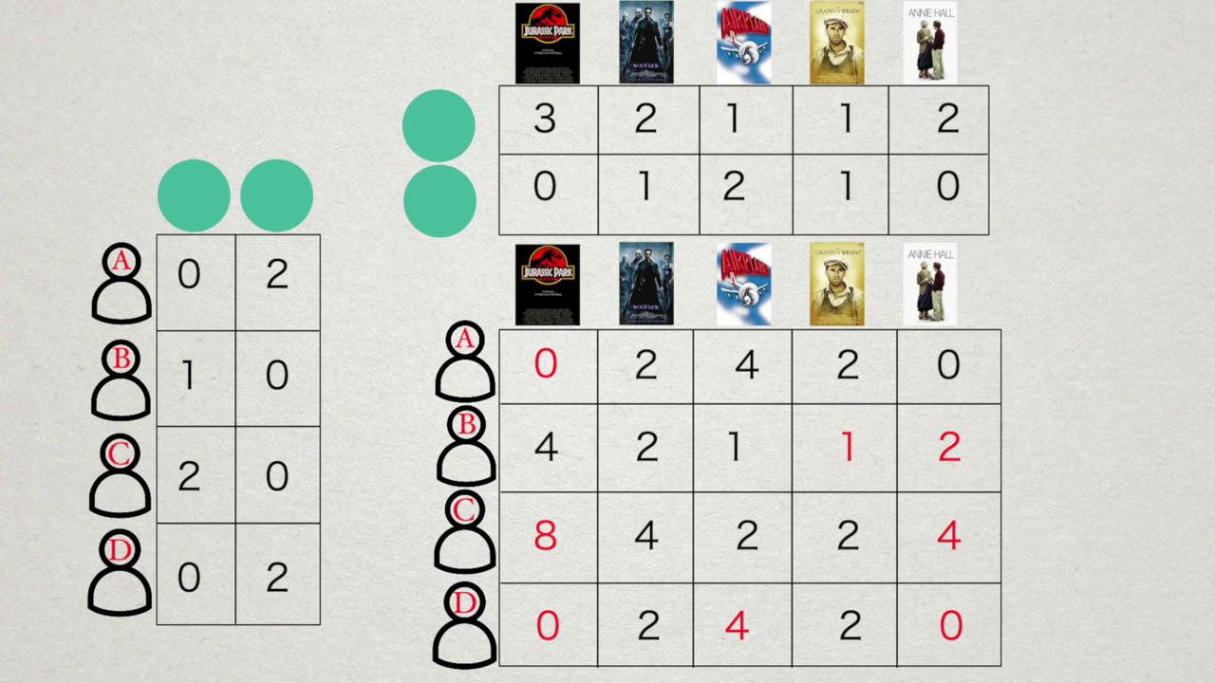
1st :Approach :Content Based Recommendation

Slide 17
2nd Approach: Content based filter
Clustering
Reinforcement learning

Slide 18
Merci Pour votre attention !

